Slide 1
Batch-4 Samesh Prabhu, Manav Ananthakumar, Aastha Singh, Surbhi Aggarawal, Tanya Yadav
Group-2

Slide 2
Comprehensive Well Evaluation: A Deep Dive into Well Analysis Case Study

Slide 3


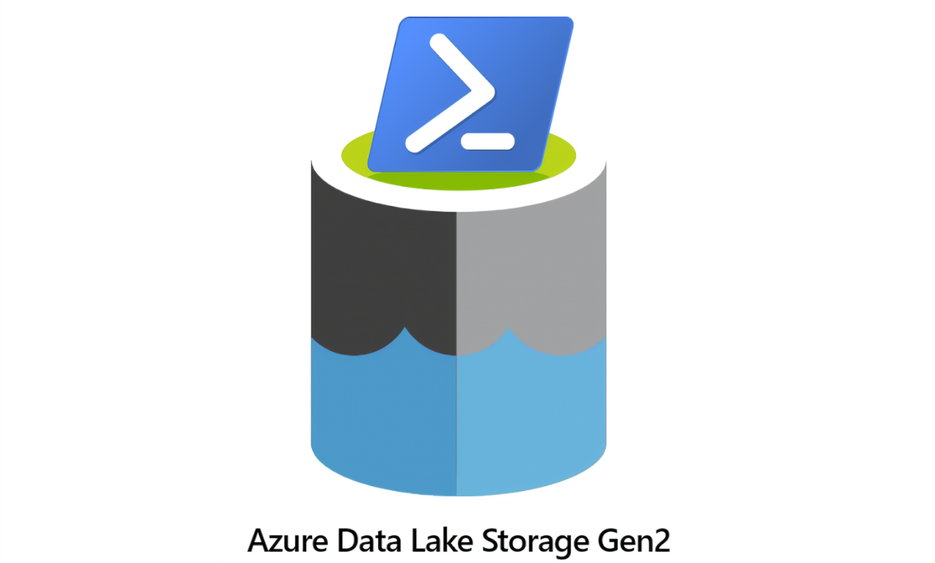
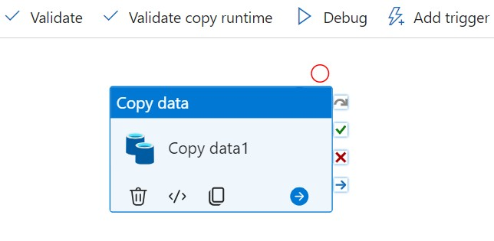




Data Flow Diagram
OPERATOR
Power BI
WELLHEADER
Raw Layer
STG Layer
Curated Layer
AZURE GEN2 STORAGE
CHEMICALS
PRODUCTIONS
Power BI
PRODUCTIONS FLARE
GEOGRAPHY
INITIAL PRODUCTIONS
Data Factory

Slide 4
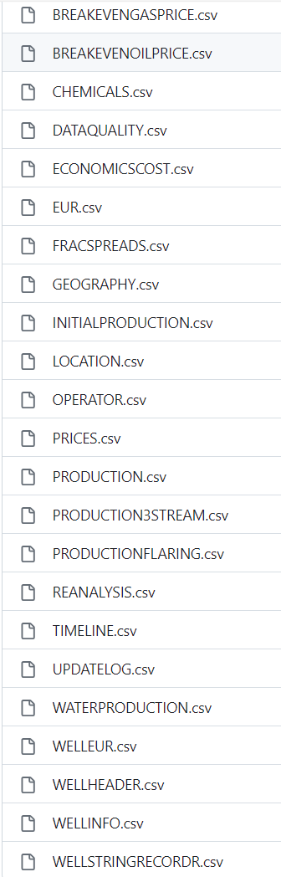
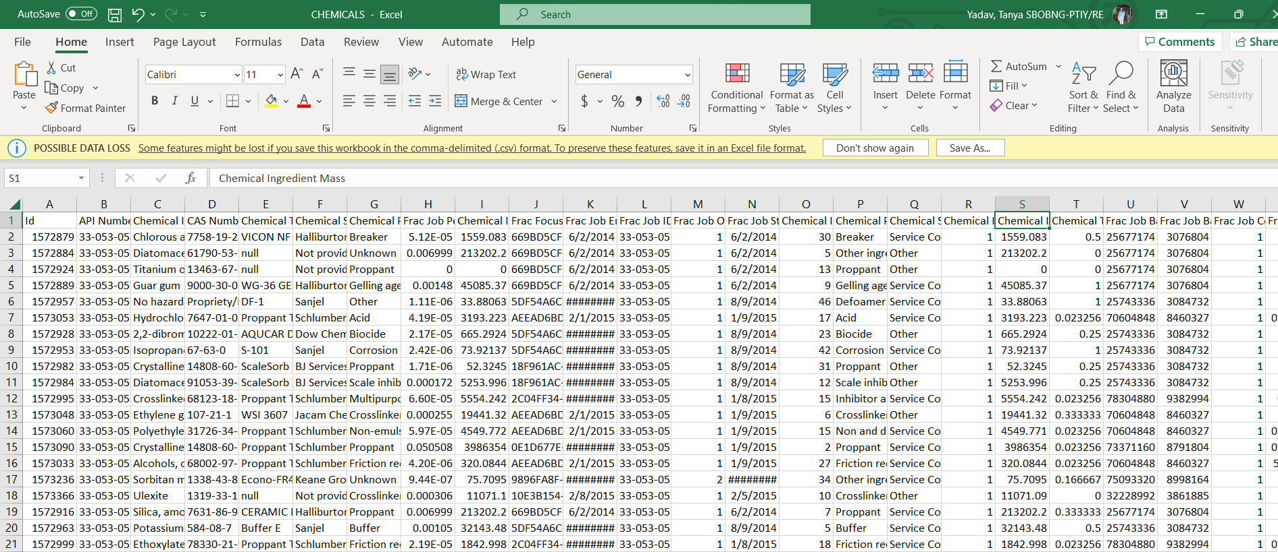
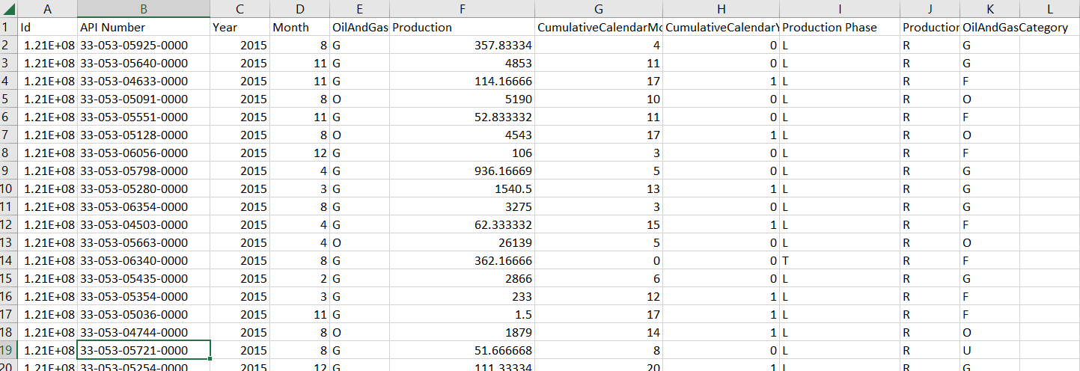
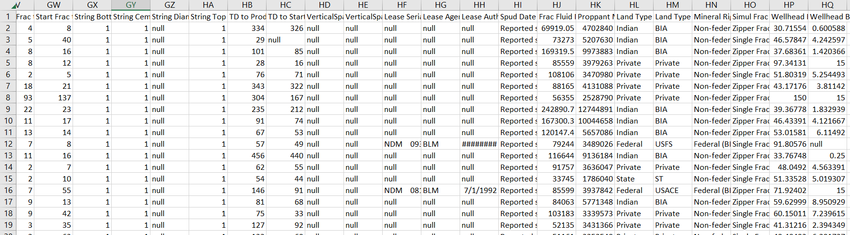
RAW

Slide 5
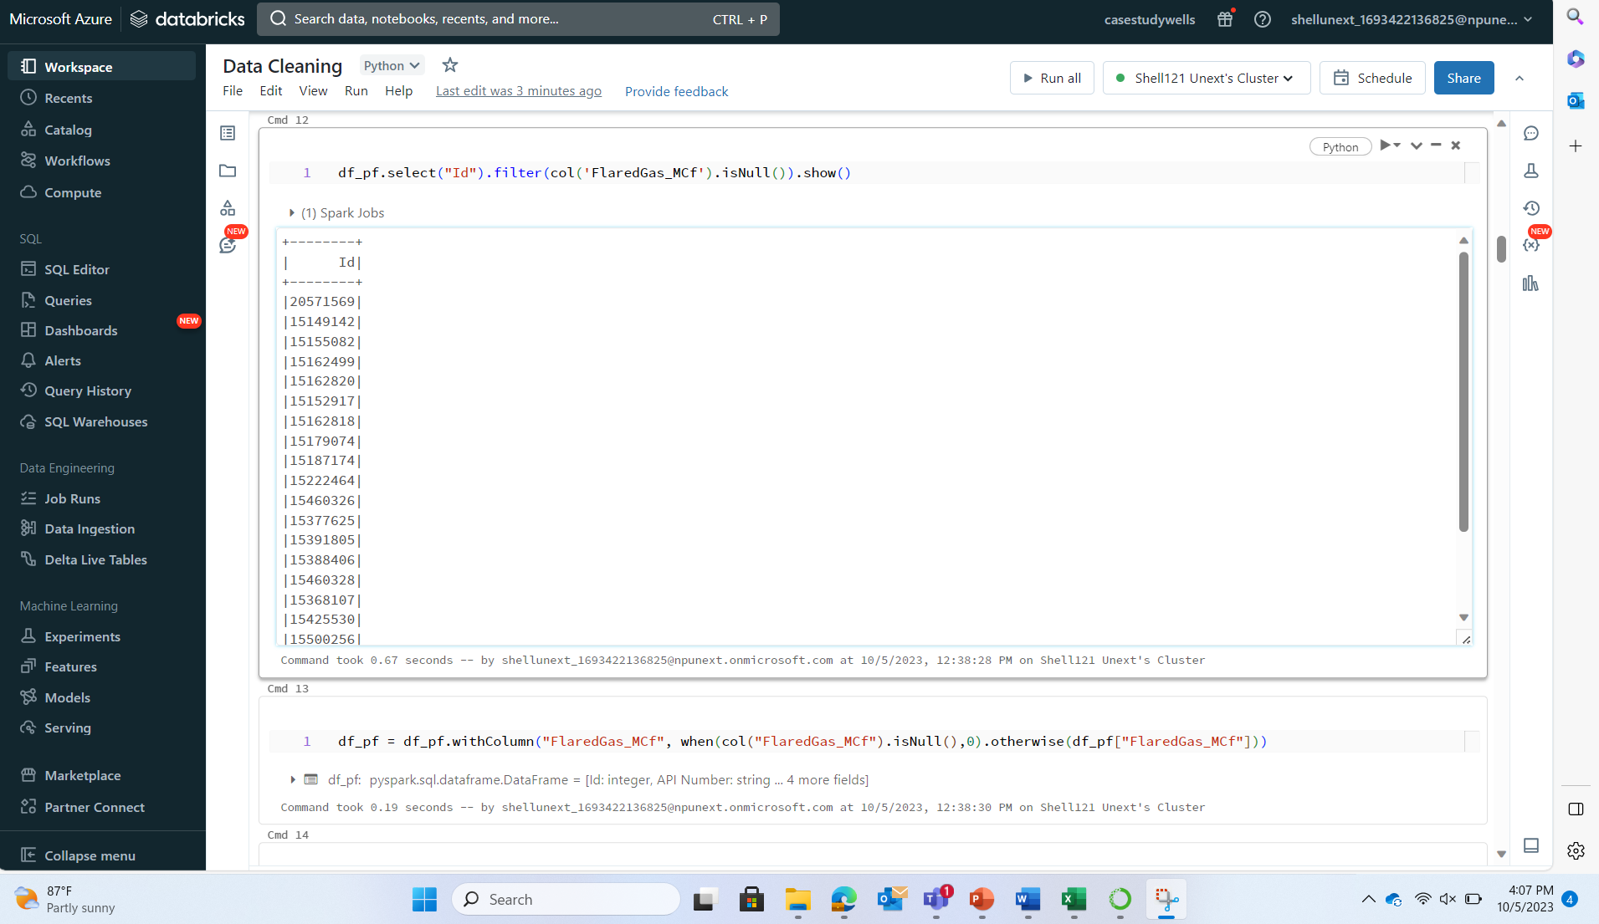
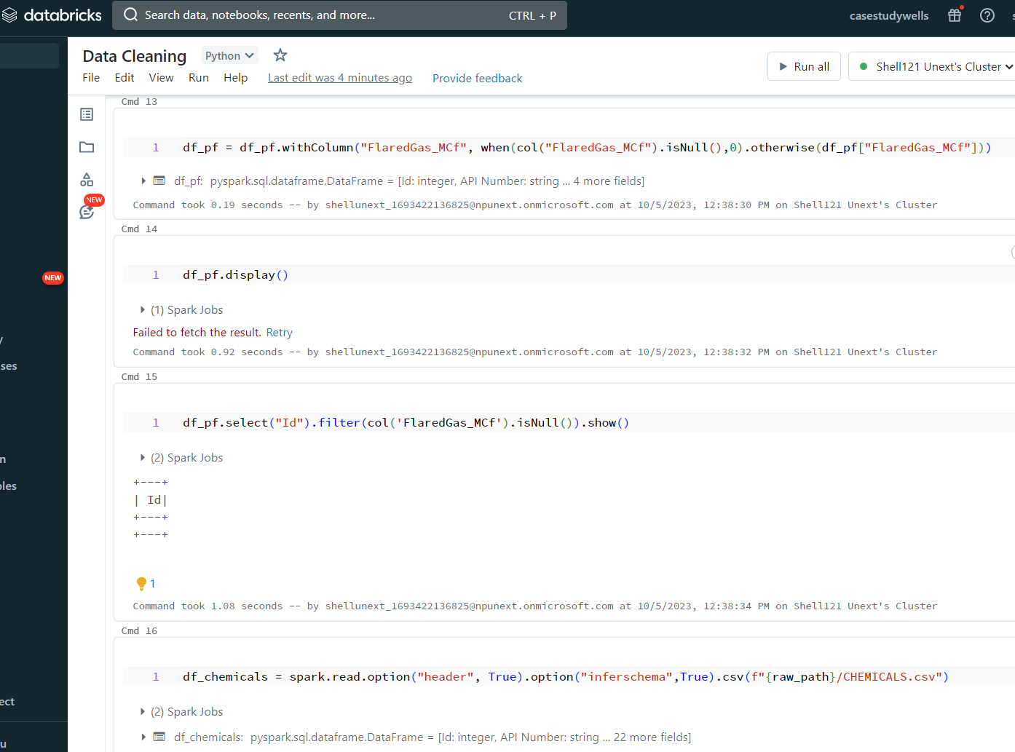
STAGING

Slide 6
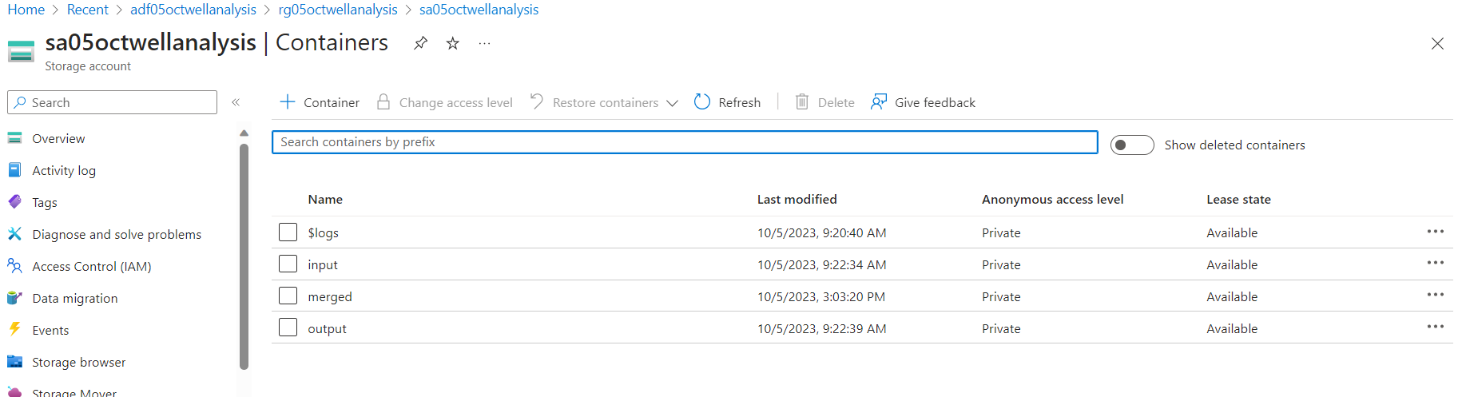
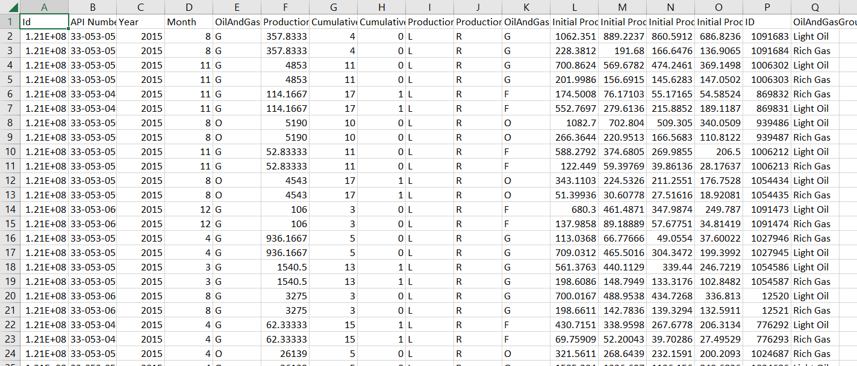
CURATED

Slide 7
Demo

Slide 8
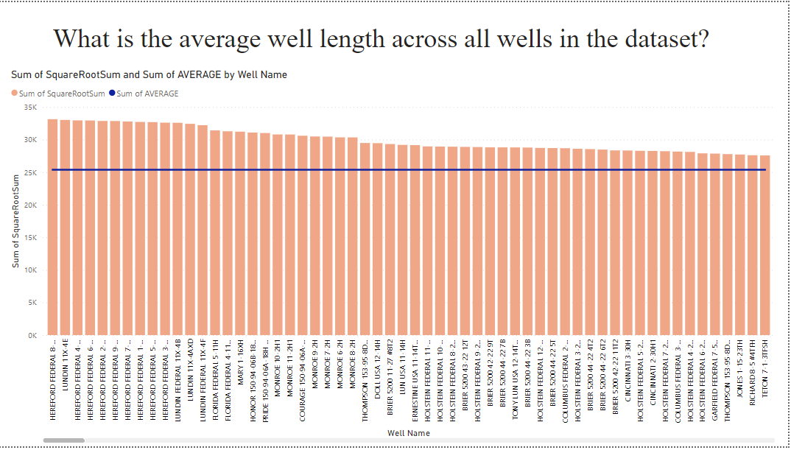
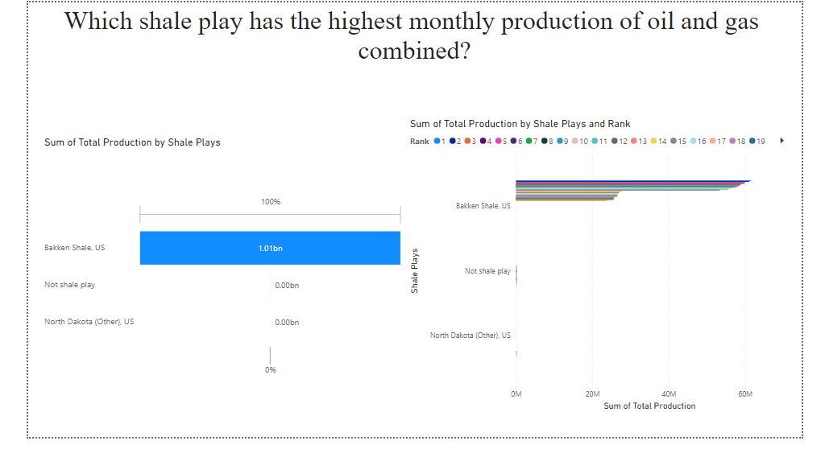
Power BI Dashboard

Slide 9
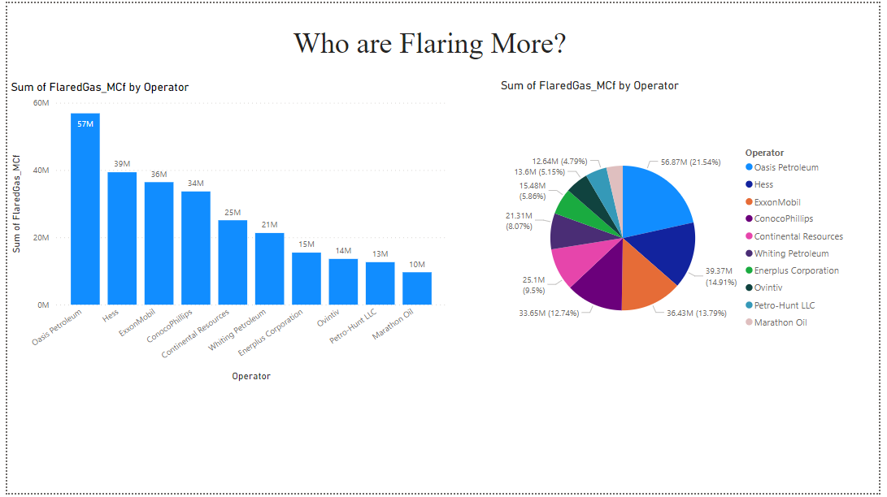
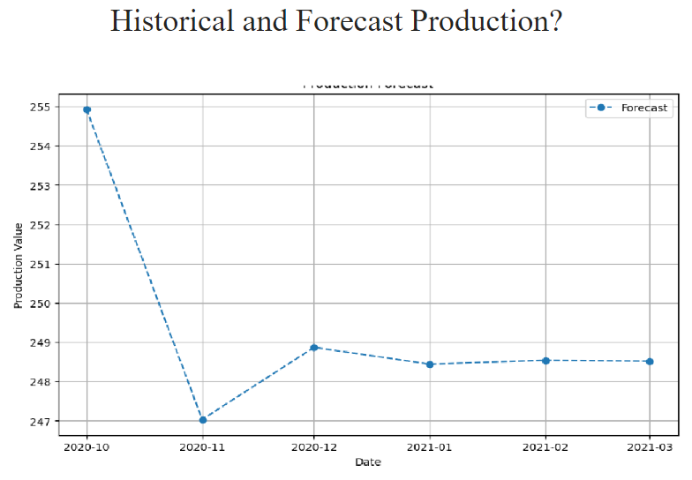
Power BI Dashboard

Slide 10
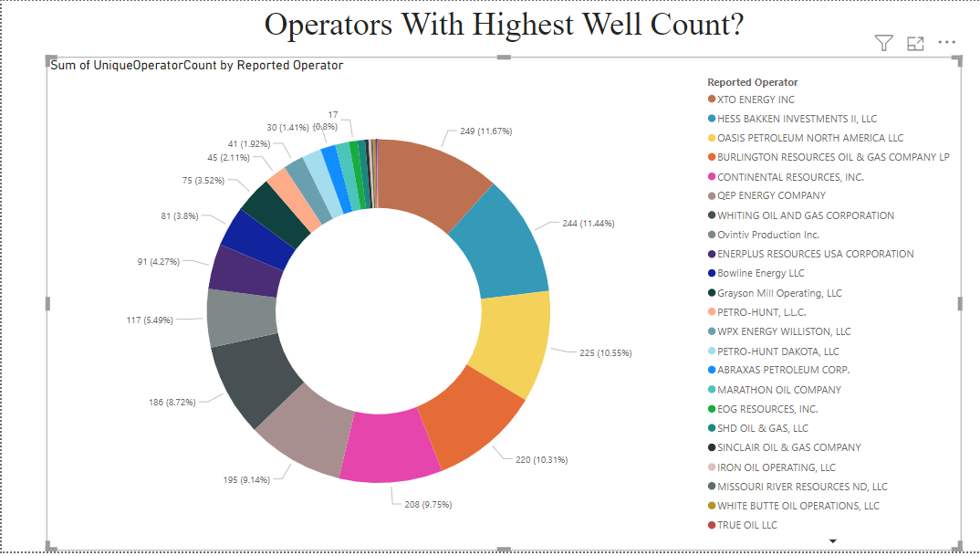
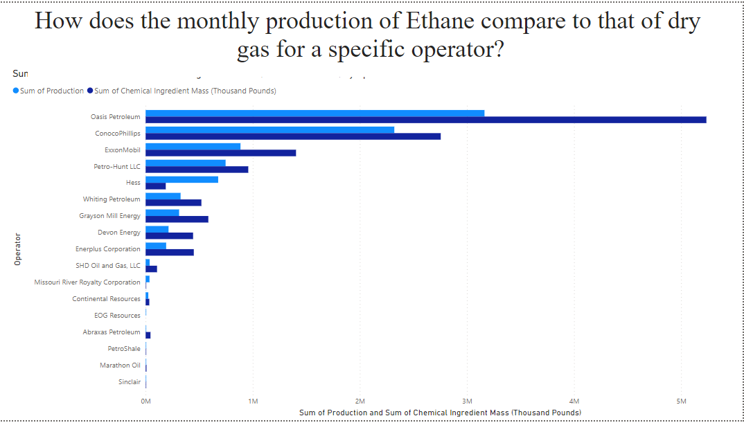
Power BI Dashboard

Slide 11
Github Link
https://github.com/DoomDust7/Shell-Final-CaseStudy

Slide 12
Q&a

Slide 13
Challenges faced
Integrating diverse datasets from ShaleWellCube.
Ensuring data quality and consistency across a vast dataset.
Finding the Foreign keys to link different tables.
Learnings
Advanced Analytics Capabilities
Utilizing Azure Databricks allows for parallel processing and optimization, aiding in scalable performance benchmarking and analysis.
Interactive Dashboards creation using Power BI.
* Keeping a regular check on technical requirements.
Feedback
Case study was a good enriching experience for us.

Slide 14
Thank you

